Slide 1
Introduction to Wireless Sensor Networks
Zigbee IP announcement
Cryptograpy and Zigbee security
WSN simulators

Slide 2
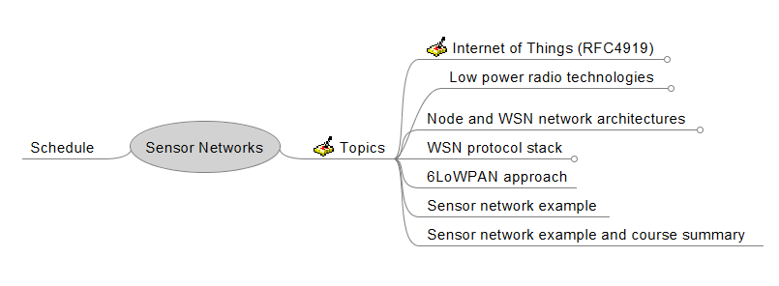
Some revision

Slide 3
Internet of Things
  Standards organizations
  Industry is going towards IP based solution
Low power radio techologies
  Shannon power vs bandwidth limited designs
  Spread spectrum is must on ISM-band
  Key radio parameters (topology, sensitivity, TX power and power consumption)
Node and Network architecture
  Zigbee non-beacon vs beacon
  Node architecture (software architecture, sensor, energy harvesting)
WSN protocol stack
  PHY, MAC, NWK, APL
  CSMA/CA, tree routing, mesh routing and source routing.

Slide 4
And today…
6LoWPAN approach
  Zigbee IP Webinar presentation (IP hour class, golden status firms and their products)
  Basics of cryptography + zigbee security
  WSN simulators, Provler

Slide 5
Assessment
Excercises during lectures 3p / each monday
Home work 3p / each week
Possible group work at the end of the course
No final exam

Slide 6
Zigbee webinar
Zigbee alliance documents
  What kind of technical challenges Zigbee IP had?
  How Zigbee IP is different from 6LoWPAN?
  Why Zigbee IP is better than Zigbee?
  Does Zigbee IP consume more energy than Zigbee?

Slide 7
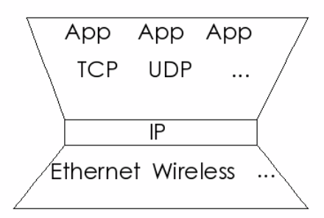
APL
IPv6
IPv6
NWK
IPv6
MAC
MAC
MAC
MAC
PHY
PHY
PHY
PHY

Slide 8
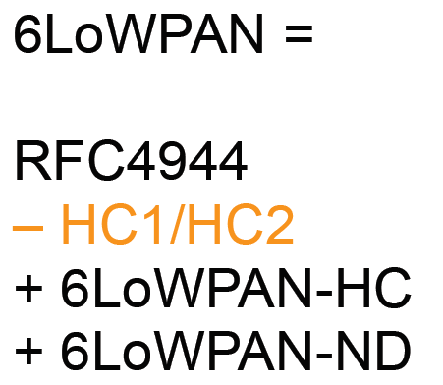
6Lowpan != Zigbee IP

Slide 9
Excercise
What products they offer HW and SW?
For whom they licence their SW product?
Exegin
Silicon Labs
Grid2Home
Sensinode
Notes:
Exegin both border router and software stack implementations for several CPU architectures
Silicon Labs EM35X chipset and software development tools (maybe also stack software as they reached golden unit status, but I did not find their zigbee IP stack in the market yet)
Grid2home provides complete software solutions (G2H stack, tools and support, reference applications). Their area is smart electric power grids.
Sensinode software stack implementations. Licensing it’s stack to chip manufacturing companies

Slide 10
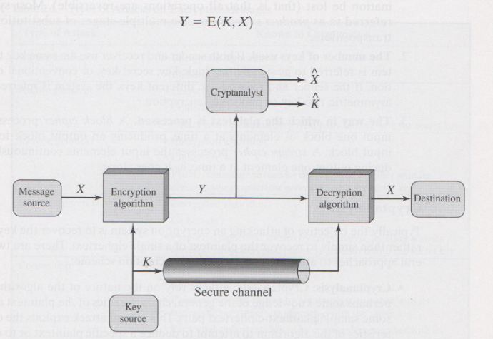
Cryptography
Is based on substitution and transposition methods.
Secure key length must be long to prevent brute force attack

Slide 11
Information security
Goals of information security:
Confidentiality
Integrity.
Availability
Access control
Non-repudiation
Authentication
Notes:
Confidentiality = Information can be accessed only by authorised personel.
Integrity = Unauthorized persons can not change information content.
Availability = Backup copies, reliable powering and network connections, etc.
Access control = only identified user or program can access information.
Non-repudiation = Information changes can be tracked to the person on program who changed the information.
Authentication = Information user is identified by key, passwork, finger print, retina, etc.

Slide 12
Ciphering algoritms
Method how plain text is ciphered
  Substititution
  Transformation
Number of keys
  Symmetric = single key = secret key = conventional encryption
  Asymmetric = two key = public key encryption
Method how plain text is processed
  Block cipher
  Stream cipher

Slide 13
Cryptanalysis:
Methods
  Brute force
  Frequency analysis
  Time analysis
What is known by an attacker
  Ciphering algorithm and cipher text
  Ciphering algorithm and known plain and cipher text pair
  Ciphering algorithm and chosen plain text and corresponding cipher text
  Ciphering algorithm and chosen cipher text and corresponding plain text

Slide 14
Excercise
There are 8 attack types that are typically used against communication networks. What might those attacs be?
Encryption prevents some ot those attacks which one?
Notes:
Disclosure = Message is revealed to someone who was not the intented recipient.
Traffic analysis = How much and how frequent messages are transmitted.
Masquerade = Somebody is pretending to be somebody else. He/she can for example acknowledge messages that have not yet reach their intented end node.
Content modification (or destruction)
Sequence modification. Messages are coming in wrong order.
Timing modification.
Source repudiation. Source denies newer sending the message.
Destination repudiation. Destination denies newer receiving message.
Encryption prevents attacks 1-2
Attacks 3-6 can be prevented with autentication
Attacks 7-8 require digital signature = public key cryptography

Slide 15
Link encryption
  Network-layer headers are protected
  Makes traffic analysis more difficult
  Each link must have own secret key
End to end encryption
  Network-layer headers are not protected
  Addresses and traffic profile is open.
Zigbee IP specifies both link and end to end encryption.

Slide 16
Excercise
Zigbee (IP or not) network has 5 router nodes that can talk to each other. How many link keys do you need if each link has unique key?
Notes:
In general you need (N(N-1)) / 2 keys, where N is number of nodes.

Slide 17
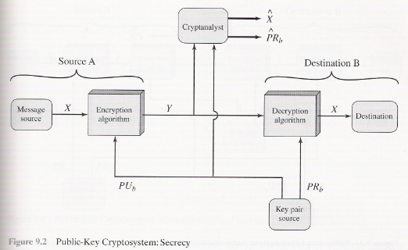
Public-key cryptography

Slide 18
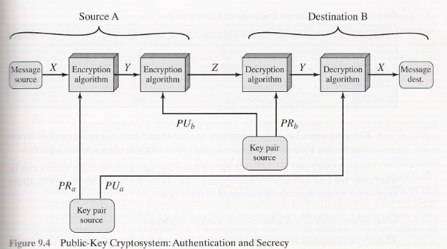
Two ways to use key-pair

Slide 19
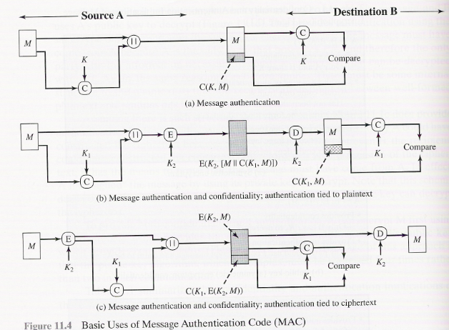
Message Authentication Code (MAC)

Slide 20
Summary of cryptograpy basics
Symmetric encryption is used to protect links and end to end applications.
Public-key encryption is used with key distribution problems and with digital signatures. Public key is too computationally intensive to be used for data encryption
MAC and HASH signatures are used to message integrity protection.
Nonce = random number is used in various security protocols to uniquely identify message source
Notes:
Zigbee uses AES-128 block cipher for data encryption and CCM* for message integrity protection

Slide 21
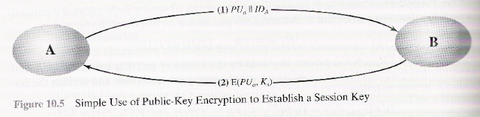
What is a problem with this key distribution skenario?
Notes:
Attacker can receive A’s message. Create new key-pair and send attacker’s public key to B.
B responds with encrypted message. Attacker can open the message as it is encrypted with Attackers public key.
Attacker can then send message to A encrypted with A’s public key.
Neither A nor B does not know that attacker is in between.

Slide 22
Zigbee security questions
Zigbee uses 5 different security keys. Where each key is used?
Which instance in a Zigbee network makes link and network keys?
How link key is given to Zigbee nodes?
How many times AES-CCM can be executed when a node sends a message to another node?
Two possible security attacks are presented. How these can happen?
Notes:
1. Link key, Network key, Master key to extablish link key. Key transport key for transmission of link or network key. Key-load key for transmission of master key.
2. Trust center. There is only one trust center in a Zigbee network. Address of a trust center is determined by Zigbee coordinator.
3. Preinstallation => manufacturer embeds the key in the node. Key transport method, where node APS sublayer asks trust center to send link key. Key-transport key can be used to secure transmission of link key. Key establishment method = symmetric key establishment method
4. Three times at MAC, NWK and APS layer. And always hearder + sec header + payload data is encrypted and MIC calculated.
5. Same nonce-attack. Same nonce is used for two consecutive messages. After node boot node might use same nonce value. Denial of service attack, where attacker sends a encrypted frame (wrong key). If receiver does not check MIC receiver can accidentally decode maximum frame number and after that node does not accept smaller frame numbers.

Slide 23
WSN simulators
Read about Prowler WSN simulator from given document and answer:
Where Prowler and also other WSN simulators are good for?
If you simulate either Zigbee or Zigbee IP with Provler, can you trust the results?
Notes:
Radio channel modelling, including MAC
Communication and routing protocol development
Debugging
Parameter tuning and optimization
Application prototyping.

Slide 24
Group excercise (2-3 persons) (1-3p)
For what AES-CCM* is used in Zigbee?
What is the reason that link key must be changed periodically?
What are the biggest differences between Zigbee and Zigbee IP protocol layers?
What can you do with WSN simulators?

